Slide 1
Upgrading to Windward From Formstack

Slide 2
Saving Time & Money
Create Templates in
MS Word
Benefits
Big Wins
Formstack’s DocBuilder is too limited for most use
Adding new functionality, like drag & drop
Saving you time. A lot of time.
Making the design process pleasant
Forms – use Microsoft Power Platform instead
The Windward Designer
Data Routing ++

Slide 3
Forms from Power Platform
Windward uses Microsoft Power Platform for forms.
An industry standard that many already know how to use
An incredibly easy-to-use form builder
You do not gain (or lose) any significant features or functionality.
Your win is using an industry standard
And designing forms will be faster & easier

Slide 4
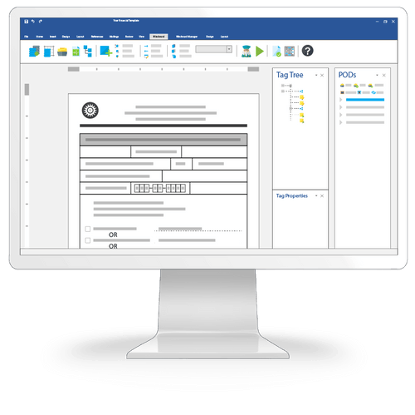
The Windward Designer
Microsoft Office Add-in
Windward is built around an add-in to help you place & edit the fields (tags in Windward nomenclature) in the template.
The Windward Designer makes adding and revising tags a breeze because it works on the tag in the template. And while helping to write each tag, it can do so in the context of where the tag is in the template.
You can, from the designer, access any object in any datasource, to use in the template. And as the designer provides it, you no longer need to memorize or copy all the mapped fields.
Control tags can be hidden or revealed immediately with a click.

Slide 5
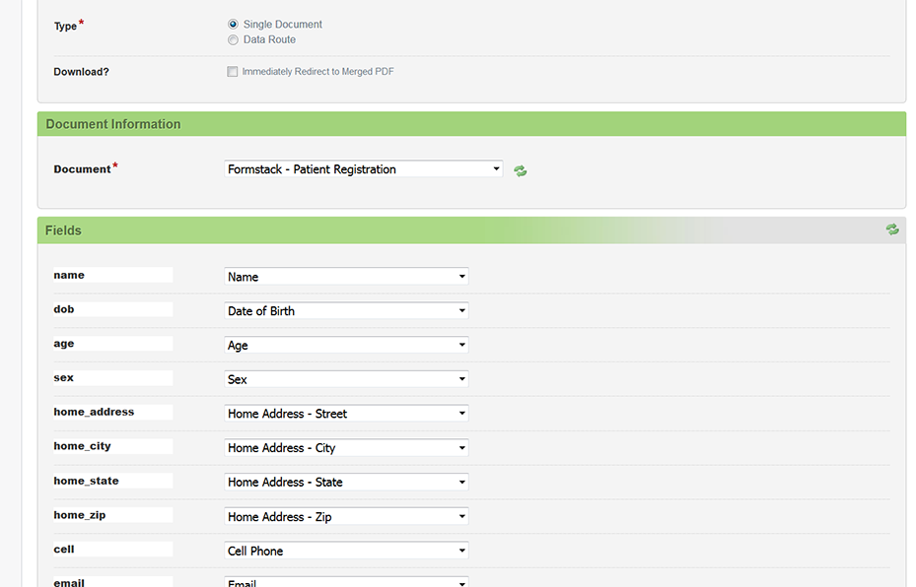
Eliminating Field Mapping
Eliminate the concept of mapping fields.
Everything is in the template including the queries to the datasources.
Eliminates the need to have DBAs involved in template design.
No more going to the data routing each time you need another field.

Slide 6
Drag & Drop Doclets
One (or several) users can create content for a template that are saved off. Then they or other users can drag those saved doclets to drop onto a template. This provides template designers a way to create very complex templates easily by dragging the needed components. It also eliminates repetitive tasks. (In Windward, these are called PODs.)
Any part of a template you can select can be saved as a POD
The POD is linked so any change to the POD is immediately reflected in the template and in any generated documents.
When dropping a POD, the full style & formatting is inserted
PODs can easily be shared among users
PODs can include tags of any complexity

Slide 7
Query Wizards
Your most common activity creating templates is writing the queries to select the data.
With query wizards, business users can write the query to pull data.
Distinct wizards for: JSON, Odata, Salesforce, SQL, & XML.
User selects data in the moment – that’s gigantic
No errors due to typos
Easy to find/get the data you want
Arguably more important, the designer understands the data and then uses it appropriately.

Slide 8
Document Automation
This is all provided by Windward’s integration with Power Platform: Scheduling
Triggering (data routing) document generation from datasource activity
Routing generated packages
Forms (interviews) to collect data
With Power Platform you gain:
Using Microsoft’s industry standard
Can connect Windward to other applications to make document automation part of larger processes

Slide 9
What Goes Away
Mapping Fields
Everything is in the template
Writing Fields by Hand

Slide 10
Formstack Only Features
Fillable PDFs
Delivery
There are a few delivery endpoints Formstack support that Windward does not
Formstack Sync
Formstack Payments
Data Routing
Formstack Portals
There are a few datasources Formstack supports that Windward does not

Slide 11
Windward Only Features
PODs – drag & drop doclets
Formulas
Including standard & custom macros
Charts (from data)
No 3rd party web designer
Built around native Word charts
Access Providers
Import files using any protocol
Query data directly in the template
From multiple datasources
Document Locking
Carries Word & Excel locking to output
Output to over 20 file formats
Process Embedded Office Objects
Including direct to printers
Process tags in embedded OpenXML objects
Imported child templates
Headers & footers optionally included
Child styles & format merged

Slide 12
Reasons to NOT UPGRADE
Your Formstack system is running fine
No new templates to create
No templates to revise
You need a datasource or delivery endpoint only Formstack supports
You need Formstack sync, payments, and/or portals
Notes:
<a href='http://www.freepik.com/free-photo/skyscraper-urban-view_881301.htm'>Designed by Freepik</a>

Slide 13
Reasons to UPGRADE
You need faster turn-around
You want to empower business users to fully design templates
You need to access multiple datasources in a template
You need the advanced features Windward provides
You need to reduce time programmers spend on templates
You need to eliminate mapping changes when documents need additional data, or you want to eliminate mapping altogether
Notes:
<a href='http://www.freepik.com/free-photo/skyscraper-urban-view_881301.htm'>Designed by Freepik</a>

Slide 14
Pricing
 | Windward Hub (10 users) | Formstack (10 users)
Year 1 | $600.00 | $249.00
Year 2+ | $6,120.00 | $2,490.00
Windward
Hub (Document Automation Solution)
Java Engine
.NET Engine
RESTful Engine
SAAS (coming soon)
Formstack
Document Automation Solution

Slide 15
Steps to Upgrade
Convert your Formstack templates to DOCX, XLSX, or PPTX
Run Windward’s template convertor.
Address any issues the convertor lists.
Step 1
Step 2
Map the template to the datasource in Windward Hub

Slide 16
Alternative
Run Windward & Formstack Side by Side
Use Windward for:
All new templates
Templates requiring substantial editing
Templates that need Windward only features
Keep Formstack for:
All existing templates that are fine as-is

Slide 17
Thank You
Questions?
+1 303 499 2544
sales@windward.net
Resources
Windward Studios website
A Guide to Evaluating DocGen Products
Next Step
Download & evaluate the Windward Trial
Notes:
https://pixabay.com/en/new-york-city-tribute-in-lights-sky-78181/

