Slide 1
Upgrading to Windward From Ecrion

Slide 2
Saving Time & Money
Create Templates in
MS Word
Benefits
Big Wins
Create your template in Word, Excel, or PowerPoint
More functionality than Ecrion Publisher
Adding new functionality, like document security
Saving You Time. A Lot of Time
Making the Design Process Pleasant
Forms – use Microsoft Power Platform instead
The Windward Designer
Access any field from any datasource
Eliminate data field mapping
Query Wizards

Slide 3
Forms from Power Platform
Windward uses Microsoft Power Platform for forms.
An industry standard that many already know how to use
An incredibly easy-to-use form builder
You do not gain (or lose) any significant features or functionality.
Your win is using an industry standard
And designing forms will be faster & easier

Slide 4
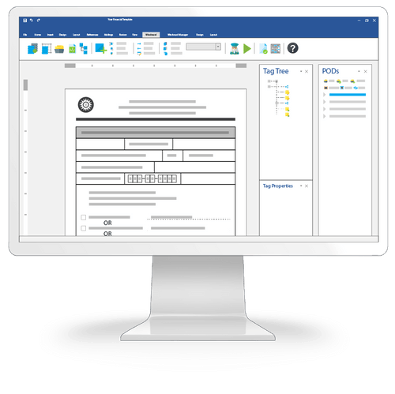
The Windward Designer
Microsoft Office Add-in
Windward is built around an add-in to help you place & edit the fields (tags in Windward nomenclature) in the template.
The Windward Designer makes adding and revising tags a breeze because it works on the tag in the template. And while helping to write each tag, it can do so in the context of where the tag is in the template.
You can, from the designer, access any object in any datasource, to use in the template. And as the designer provides it, you no longer need to memorize or copy all the mapped fields.
Control tags can be hidden or revealed immediately with a click.

Slide 5
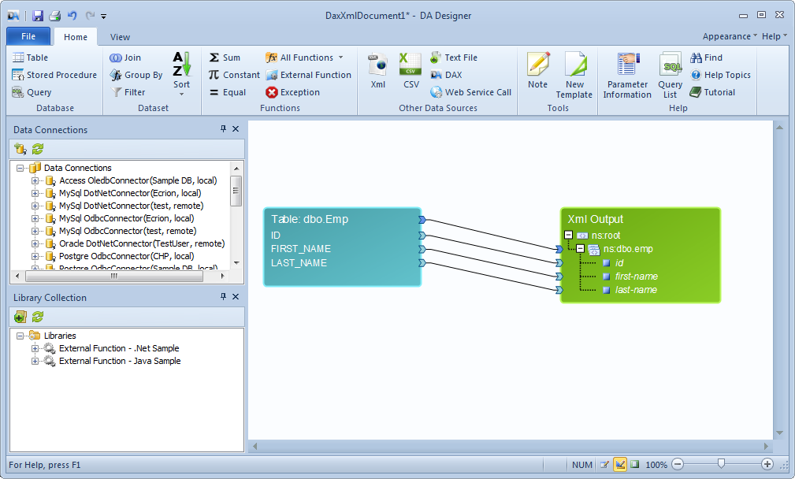
Eliminating Data Mapping
Eliminate the concept of a DataProviderBuilder
Everything is in the template, including the queries to the datasources.
Eliminates the need to have programmers involved in template design.
No more rebuilding your application and pushing it through test & staging each time you need another field.

Slide 6
Query Wizards
Your most common activity creating templates is writing the queries to select the data.
With query wizards, business users can write the query to pull data.
Distinct wizards for: JSON, Odata, Salesforce, SQL, & XML.
User selects data in the moment – that’s gigantic
No errors due to typos
Easy to find/get the data you want
Arguably more important, the designer understands the data and then uses it appropriately.

Slide 7
Document Automation
This is all provided by Windward’s integration with Power Platform: Scheduling Triggering document generation from datasource activity Routing generated packages Forms (interviews) to collect data
With Power Platform you gain: Using Microsoft’s industry standard Can connect Windward to other applications to make document automation part of larger processes

Slide 8
What Goes Away
Mapping Fields
Everything is in the template
Writing Complex XPath Queries by Hand

Slide 9
Ecrion Only Features
Detailed analytics on documents generated & forms submitted
Writing scripts inline in fields
Windward does this via custom macros
Sub-templates are displayed inline in the template
Working with/in XSLT-FO
Auto-translate static text to other languages
Setting any formatting property from data
In our opinion, this is asking for trouble.
Windward sort of has this with Office Schemes

Slide 10
Windward Only Features
Query data directly in the template
Access Providers
From multiple datasources
Import files using any protocol
Document Locking
Text boxes
Carries Word & Excel locking to output
Query Wizards
Process Embedded Office Objects
Enable business users to easily craft complex queries to retrieve any data
Process tags in embedded OpenXML objects

Slide 11
Reasons to NOT UPGRADE
Your Ecrion system is running fine
No new templates to create
No templates to revise
You need the auto translation
Notes:
<a href='http://www.freepik.com/free-photo/skyscraper-urban-view_881301.htm'>Designed by Freepik</a>

Slide 12
Reasons to UPGRADE
You need faster turn-around
You want to empower business users to fully design templates
You need the advanced features Windward provides
You need to reduce time programmers spend on templates
You need to eliminate mapping changes when documents need additional data
Or you just want to eliminate mapping altogether
Notes:
<a href='http://www.freepik.com/free-photo/skyscraper-urban-view_881301.htm'>Designed by Freepik</a>

Slide 13
Pricing
 | Windward Hub (10 users) | Ecrion
Year 1 | $600.00 | NOT PUBLICLY AVAILABLE
Year 2+ | $6,120.00 | NOT PUBLICLY AVAILABLE
Windward
Hub (Document Automation Solution)
Java Engine
.NET Engine
RESTful Engine
SAAS (coming soon)
Ecrion
Document Automation Solution

Slide 14
Alternative
Run Windward & Ecrion Side by Side
Use Windward for:
All new templates
Templates requiring substantial editing
Templates that need Windward only features
Or use Windward’s tools to convert your Docmosis data & templates
And use the data as built run through our convertor
Keep Ecrion for:
All existing templates that are fine as-is

Slide 15
Thank You
Questions?
+1 303 499 2544
sales@windward.net
Resources
Windward Studios website
A Guide to Evaluating DocGen Products
3rd party reviews of Windward vs. Ecrion
Next Step
Download & evaluate the Windward Trial
Notes:
https://pixabay.com/en/new-york-city-tribute-in-lights-sky-78181/

